Slide 1

Cloud Computing and Distributed Systems
Week-7
Mayank Taneja,
Teaching Assistant

Slide 2
Q. 1 Which of the following is a disadvantage of the Napster peer to peer network?
A. Centralized server a source of congestion
B. Centralized server single point of failure
C. No security
D. All of the mentioned

Slide 3
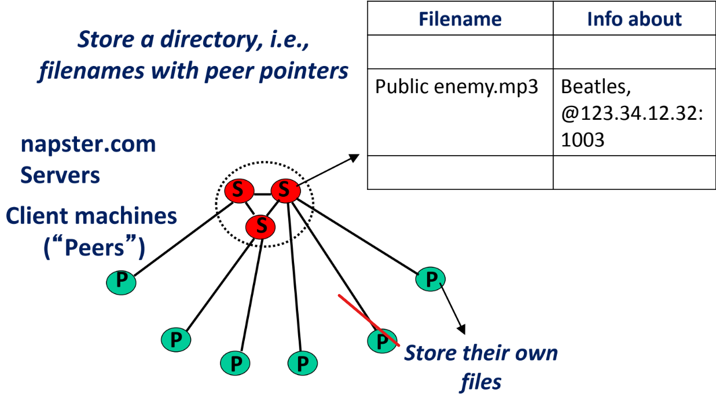

Slide 4
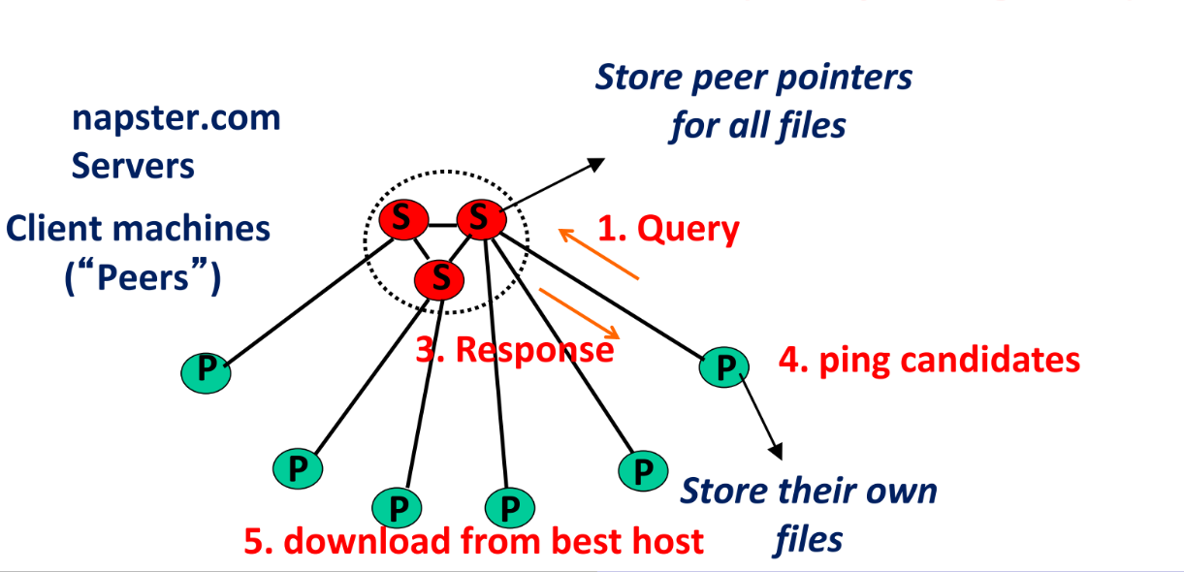

Slide 5
Issues with Napster
Centralized server a source of congestion
Centralized server single point of failure
No security: plaintext messages and passwords

Slide 6
Q. 2 True or False ?
In Chord a supernode stores a directory listing a subset of nearby (<filename,peer
pointer>), similar to Napster servers.
A. True
B. False

Slide 7
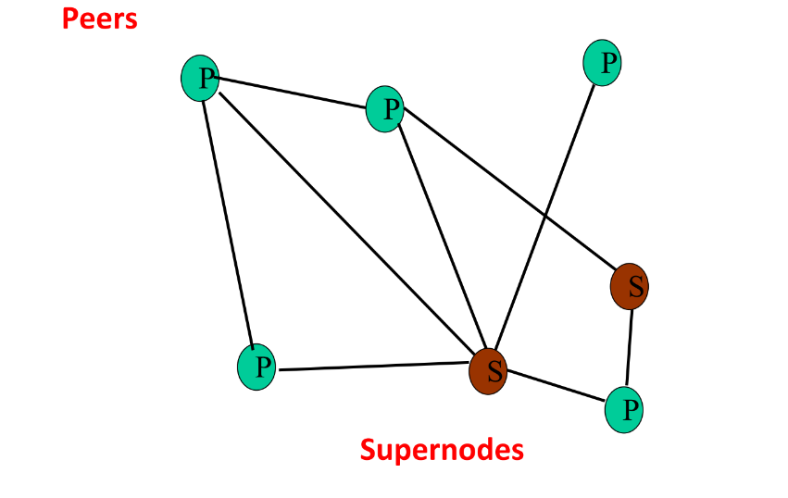
Answer: B) False
Explanation: The correct statement is:
In FastTrack, a supernode stores a directory listing a subset of nearby
(<filename,peer pointer>), similar to Napster servers.

Slide 8
FastTrack
A supernode stores a directory listing a subset of nearby (<filename,peer pointer>), similar to Napster servers
Supernode membership changes over time
Any peer can become (and stay) a supernode, provided it has earned enough reputation
Kazaalite: participation level (=reputation) of a user between 0 and 1000, initially 10, then affected by length of periods of connectivity and total number of uploads
More sophisticated Reputation schemes invented, especially based on economics
A peer searches by contacting a nearby supernode

Slide 9
Q. 3 Choose the correct items for X, Y, and Z.
X systems use Y organization of the Z for flexibly sharing resources (e.g., files
and multimedia documents) stored across network-wide computers.
A. X- Chord, Y- Network-level, Z- local network
B. X- DHT, Y- Physical-level, Z- network overlay
C. X- Peer-to-peer (P2P) network, Y- Application-level, Z- network overlay
D. X- Peer-to-peer (P2P) network, Y- Transport-level, Z- network overlay

Slide 10
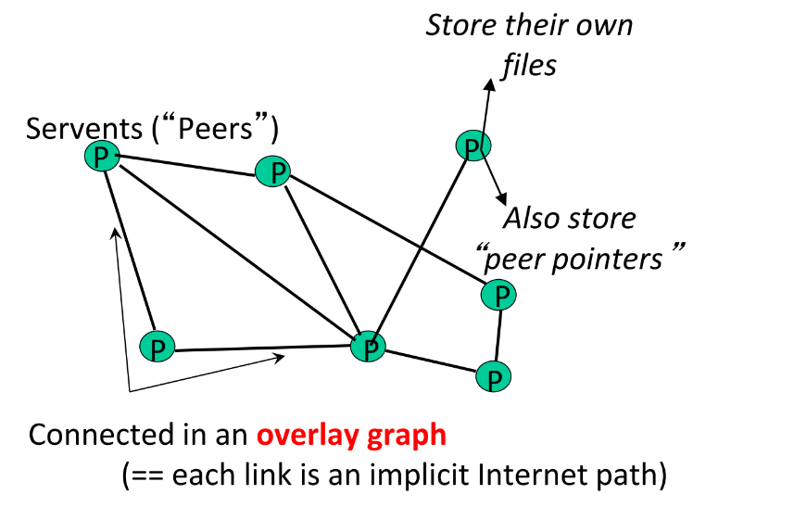
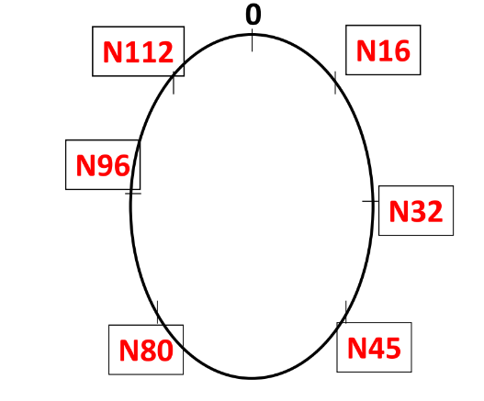
Overlay Network
An overlay network is a virtual or logical network that is created on top of an existing physical network
An overlay network is any virtual layer on top of physical network infrastructure
Nodes in the overlay network can be thought of as being connected by virtual or logical links, each of which corresponds to a path, perhaps through many physical links, in the underlying network
For example, distributed systems such as peer-to-peer networks and client–server applications are overlay networks because their nodes run on top of the Internet

Slide 11
Answer: C) X- Peer-to-peer (P2P) network, Y- Application-level, Z- network overlay
Explanation: Peer-to-peer (P2P) network systems use Application-level
organization of the network overlay for flexibly sharing resources (e.g., files and
multimedia documents) stored across network-wide computers.

Slide 12
Q. 4 Users specify a ______________function that processes a key/value pair to
generate a set of intermediate key/value pairs, and a _______________ function
that merges all intermediate values associated with the same intermediate key.
A. Reduce, Map
B. Map, Reduce
C. Chunk, Grep
D. None of the mentioned

Slide 13
MapReduce
The term "MapReduce" refers to two separate and distinct tasks that Hadoop programs perform.
The first is the map job, which takes a set of data and converts it into another set of data, where individual elements are broken down into tuples (key/value pairs).
The reduce job takes the output from a map as input and combines those data tuples into a smaller set of tuples.
As the sequence of the name MapReduce implies, the reduce job is always performed after the map job.

Slide 14
Example of MapReduce
Assume you have five files, and each file contains two columns (a key and a value) that represent a city and the corresponding temperature recorded in that city for the various measurement days.
The city is the key, and the temperature is the value. For example: (Toronto, 20). Out of all the data we have collected, you want to find the maximum temperature for each city across the data files (note that each file might have the same city represented multiple times).
Using the MapReduce framework, you can break this down into five map tasks, where each mapper works on one of the five files. The mapper task goes through the data and returns the maximum temperature for each city.
For example, the results produced from one mapper task for the data above would look like this: (Toronto, 20) (Whitby, 25) (New York, 22) (Rome, 33)

Slide 15
Assume the other four mapper tasks (working on the other four files not shown here) produced the following intermediate results:
(Toronto, 18) (Whitby, 27) (New York, 32) (Rome, 37)
(Toronto, 32) (Whitby, 20) (New York, 33) (Rome, 38)
(Toronto, 22) (Whitby, 19) (New York, 20) (Rome, 31)
(Toronto, 31) (Whitby, 22) (New York, 19) (Rome, 30)
All five of these output streams would be fed into the reduce tasks, which combine the input results and output a single value for each city, producing a final result set as follows: (Toronto, 32) (Whitby, 27) (New York, 33) (Rome, 38).
Census also example of MapReduce task

Slide 16
Q. 5 In a Gnutella P2P network with N nodes, how many number of messages
would a lookup operation require?
A. N
B. N/2
C. log(N)
D. log(logN)

Slide 17
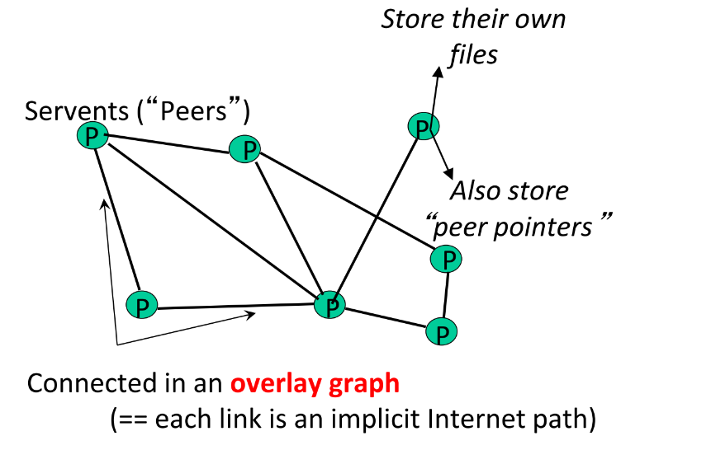
Gnutella

Slide 18
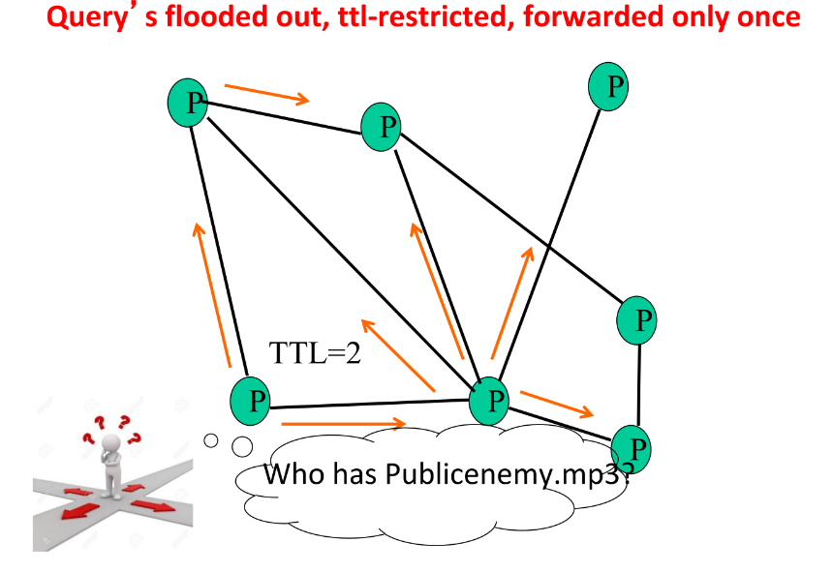
Gnutella Search

Slide 19
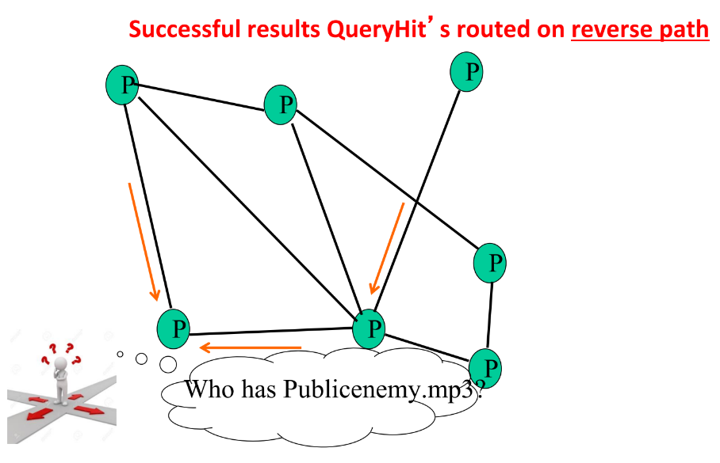
Gnutella Search

Slide 20
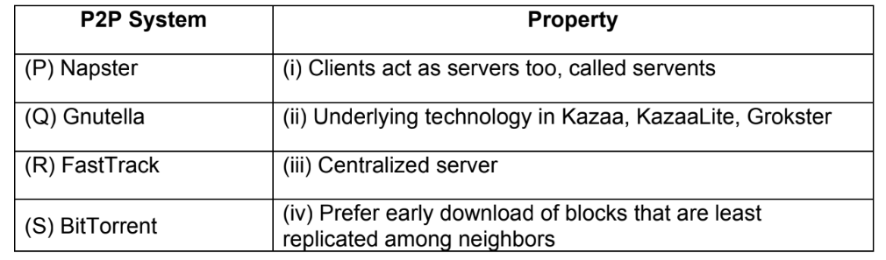
Q. 6 Consider the given table of P2P systems and find out the correct match:
A. (P): (i), (Q): (ii), (R): (iii), (S): (iv)
B. (P): (iii), (Q): (i), (R): (ii), (S): (iv)
C. (P): (iii), (Q): (iv), (R): (i), (S): (ii)
D. (P): (iv), (Q): (iii), (R): (i), (S): (ii)

Slide 21
Answer: B) (P): (iii), (Q): (i), (R): (ii), (S): (iv)
Kazaa Media Desktop and Grokster were peer-to-peer file sharing applications using the FastTrack protocol
BitTorrent uses Local Rarest First block policy to download blocks
prefer early download of blocks that are least replicated among neighbors

Slide 22
Q. 7 True or False ?
MapReduce is a programming model and an associated implementation for
processing and generating large data sets.
A. True
B. False

Slide 23
True
MapReduce is a paradigm and also an Apache Hadoop implementation that enables massive scalability across hundreds or thousands of servers in a Hadoop cluster

Slide 24
Q. 8 Choose the correct items for X, and Y.
The Map phase is subdivided into M pieces and the reduce phase into R pieces.
There are practical bounds on how large M and R can be, since the master must
make X scheduling decisions and keeps Y state in memory.
A. X: O(M*R), Y: O(M * R)
B. X: O(M + R), Y: O(M + R)
C. X: O(M * R), Y: O(M + R)
D. X: O(M + R), Y: O(M * R)

Slide 25
MapReduce
MapReduce is a framework using which we can write applications to process huge amounts of data, in parallel, on large clusters of commodity hardware in a reliable manner.
A MapReduce computation takes as input a set of key/value pairs and outputs another set of key/value pairs. The computation consists of 2 parts:
Map — A function to process input key/value pairs to generate a set of intermediate key/value pairs. All the values corresponding to each intermediate key are grouped together and sent over to the Reduce function.
Reduce — A function that merges all the intermediate values associated with the same intermediate key.
A program written in MapReduce is automatically parallelized without the programmer having to care about the underlying details of partitioning the input data, scheduling the computations or handling failures

Slide 26
Execution Overview
When MapReduce function is invoked, following steps take place:
The input data is partitioned into a set of M splits of equal size.
One of the nodes in the cluster becomes the master and rest become the workers. There are M Map and R Reduce tasks.
The Map invocations are distributed across multiple machines containing the input partitions.
Each worker reads the content of the partition and applies the Map function to it. Intermediate results are buffered in memory and periodically written back to local disk.
The locations are passed on to the master which passes it on to reduce workers. These workers read the intermediate data.
Reduce worker iterates over the sorted data and for each unique intermediate key, passes the key and intermediate values to Reduce function. The output is appended to an output file.
Once all map and reduce tasks are over, the control is returned to the user program.

Slide 27
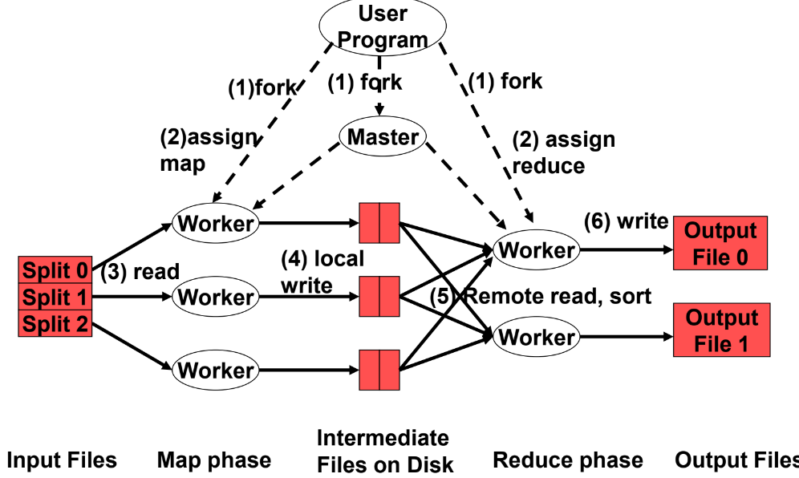

Slide 28
Master Node
The master maintains the state of each map-reduce task and the identity of each worker machine. The location of the intermediate file also moves between the map and reduce operations via the master. The master pings each worker periodically. In case, it does not her back, it marks the worker as failed and assigns its task to some other worker. If a map task fails, all the reduce workers are notified about the newly assigned worker. Master failure results in computation termination in which case the client may choose to restart the computation.
The map phase is divided into M tasks and reduce phase into R tasks.
Keeping M and R much larger than the number of nodes helps to improve dynamic load balancing and speeds up failure recovery.
Since the Master needs to manage each Map and each Reduce, it must make O(M+R) scheduling decisions.
Since there is state associated with each Map-Reduce pair, it must maintain O(M*R) state information.
Therefore, value of M and R cannot be arbitrarily large

